Slide 1

Data Modeling
Spatial Gaussian Regression Model
:
Time spent to put out the fire (days) at location s
:
Spatial random effect
:
Coordination (Lon,Lat) at location s
:
Random noise
:
Coefficients need to be estimated
Notes:
W(s) : to quantify if there is a spatial dependence between two locations
The objective: To predict how much time the fire will last in a specific location (S)

Slide 2
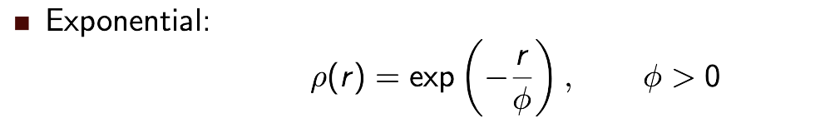
Data Modeling
:
Spatial random effect
Gaussian Process with mean = 0 and covariance = 𝝈^2 * 𝙥 (r) where 0 < 𝙥 (r) < 1
We will estimate 𝝈^2 : applying a simple linear regression model (fit.lm) not considering the data as a spatial data and take the variance of the output
We will estimate 𝙥 (r): applying exponential covariance function with the following parameters:
  r = The distance between two locations
  𝜙 = Spatial range parameter estimated as (the maximum of distance matrix / 3 * 2)
Notes:
This is the most important part of the model because this function will decide if there is a spatial dependence between two locations or not
Phi = to control how fast the function will decline from 1 to 0
So , for example here when we take distance between two locations to be very high … the covariance function will be close to 0 then the covariance will be also close to zero that means that there is no spatial dependence between the two locations

Slide 3
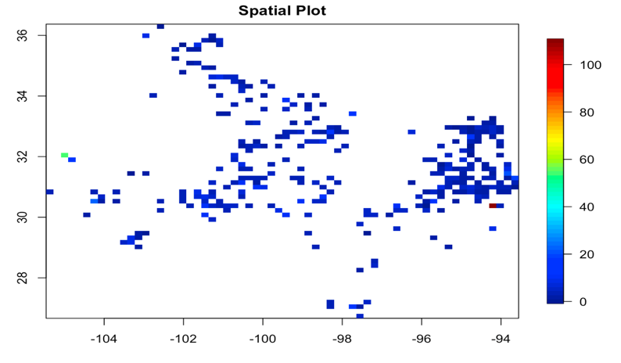
Data Modeling
Language : R
Data set : Natural fire – Texas
Total observations: 530
80% training and 20% testing
Notes:
This is the most important part of the model because this function will decide if there is a spatial dependence between two locations or not
Phi = to control how fast the function will decline from 1 to 0
So , for example here when we take distance between two locations to be very high … the covariance function will be close to 0 then the covariance will be also close to zero that means that there is no spatial dependence between the two locations

Slide 4
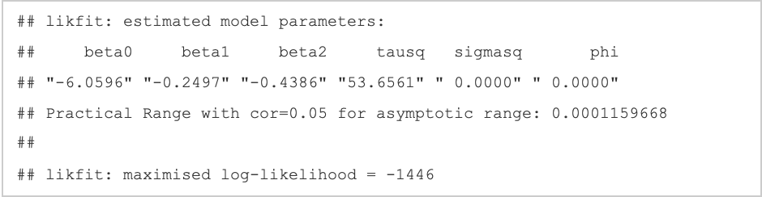
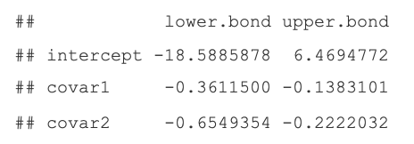
Data Modeling
fit_mle <- likfit(data=Y.train,coords=coords.train,
trend = ~ X.train[,1]+X.train[,2],
fix.nugget=F,cov.model="exponential",ini = c(ini.sigma.sq,ini.phi))
Notes:
This is the most important part of the model because this function will decide if there is a spatial dependence between two locations or not
Phi = to control how fast the function will decline from 1 to 0
So , for example here when we take distance between two locations to be very high … the covariance function will be close to 0 then the covariance will be also close to zero that means that there is no spatial dependence between the two locations

Slide 5
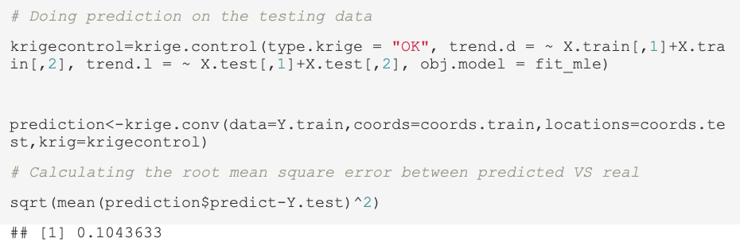
Data Modeling
Notes:
This is the most important part of the model because this function will decide if there is a spatial dependence between two locations or not
Phi = to control how fast the function will decline from 1 to 0
So , for example here when we take distance between two locations to be very high … the covariance function will be close to 0 then the covariance will be also close to zero that means that there is no spatial dependence between the two locations

Slide 6
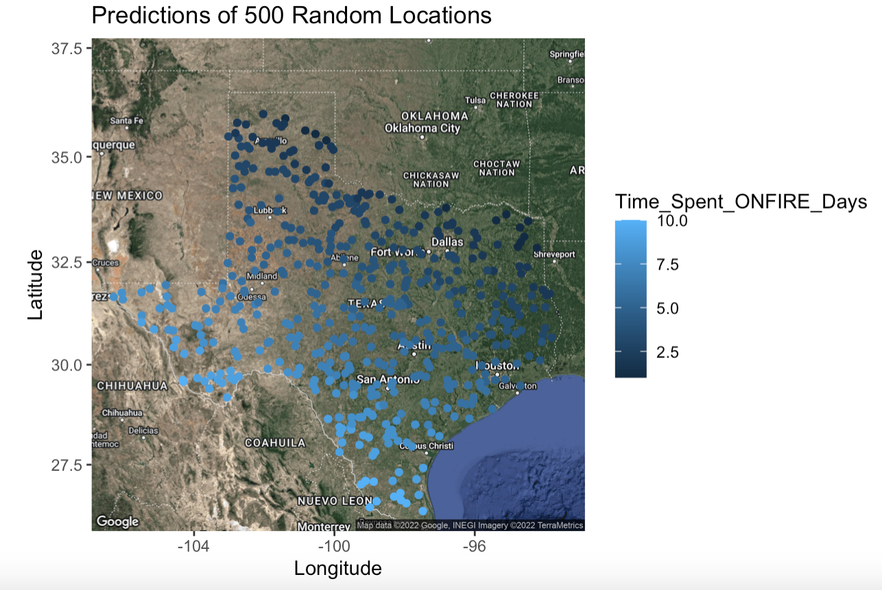
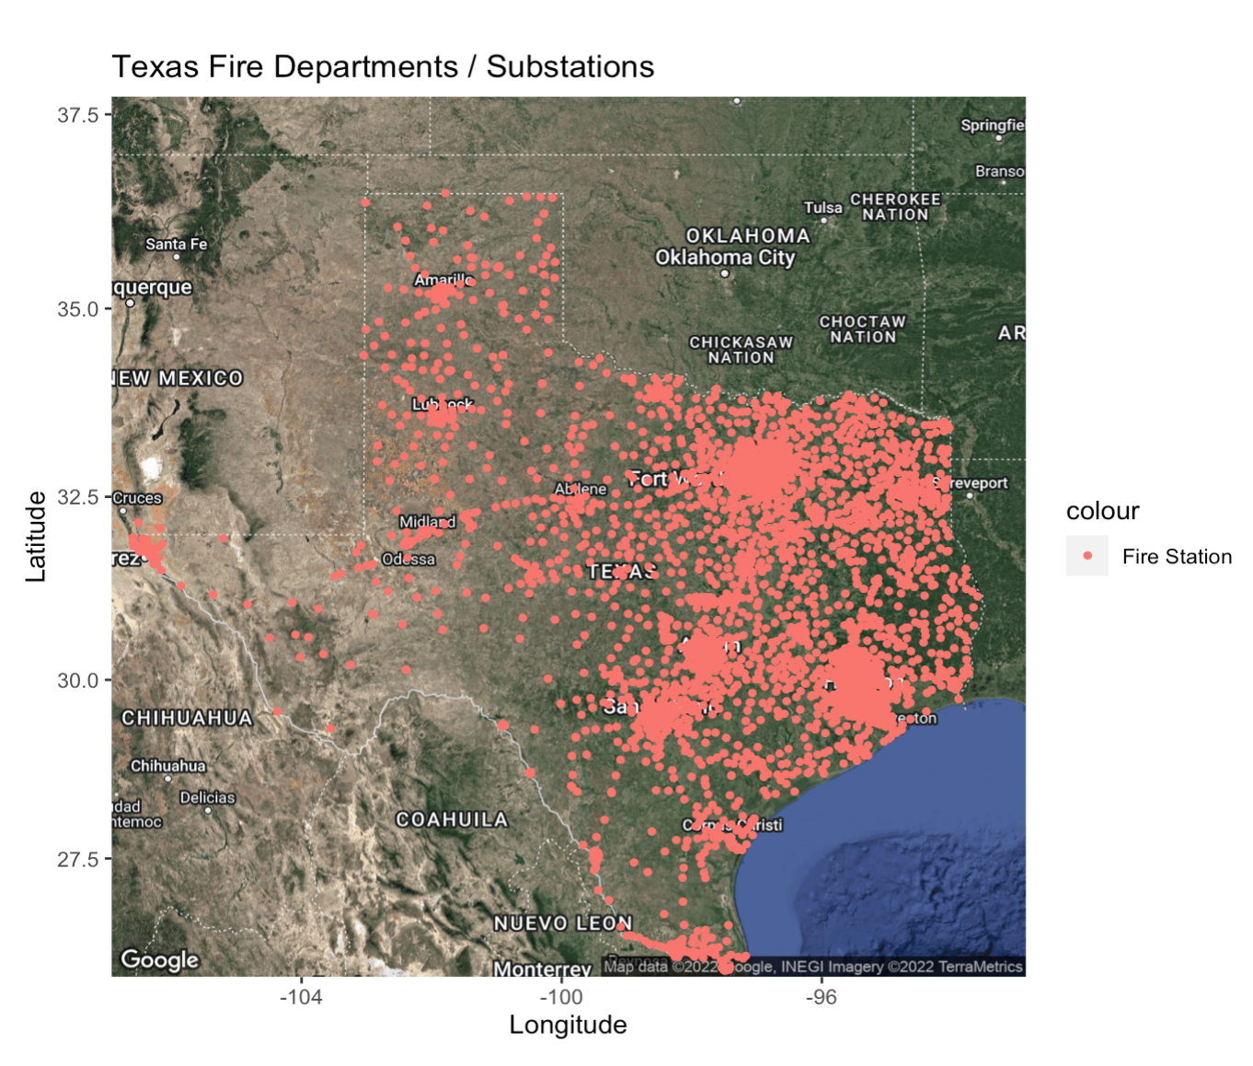
Data Modeling
We use our model to predict on 500 random locations in Texas
Notes:
This is the most important part of the model because this function will decide if there is a spatial dependence between two locations or not
Phi = to control how fast the function will decline from 1 to 0
So , for example here when we take distance between two locations to be very high … the covariance function will be close to 0 then the covariance will be also close to zero that means that there is no spatial dependence between the two locations

